Slide 1
FUNDAMENTALS
Lecture-1
Basics of Problem Solving
Flowcharts, PseudoCode
Prateek Narang

Slide 2
Course Structure
Basics of Problem Solving
Programming Fundamentals
Object Oriented Programming
Data Structures

Slide 3
Course Administration
Piazza Online Class ( www.piazza.com )
Regular Assignments (www.hackerrank.com)
Laptops

Slide 4
What does a computer do?
Computer
Input
Output

Slide 5
Tool for solving problems with data
To communicate the solution we create Programs.
So a program is a sequence of instructions that tells a computer how to perform a task.
When computer follows the instructions we say it executes the program.

Slide 6
It’s a machine!
Computers are a machine, and at the most basic level, they are collection of switches – where 1 represents “on” and 0 represents “off”.
Everything that a computer does is implemented in this most basic of all numbering systems – binary
So if you want to communicate directly we need to talk to in binary

Slide 7
What does machine understands?
Binary Instructions
R Type
[op | rs | rt | rd | shamt | funct]
I Type
[op | rs | rt | address/immediate]
J Type
[op | target address ]
Notes:
What does Computer understands is MACHINE CODE Or BINARY CODE
MIPS
R-
000000 00001 00010 00110 00000 100000
add $1 $2 $6
$6 = $1 + $2
I-
100011 00011 01000 00000 00001 000100
$8 = content of ($3 + 68)
J-
000010 00000 00000 00000 10000 000000
Jump to address 1024
jal
Operation code – such as addition or subtraction.
Operands – that identify the data to be processed.
Machine language is machine dependent as it is the only language the computer can understand.
Very efficient code but very difficult to write.

Slide 8
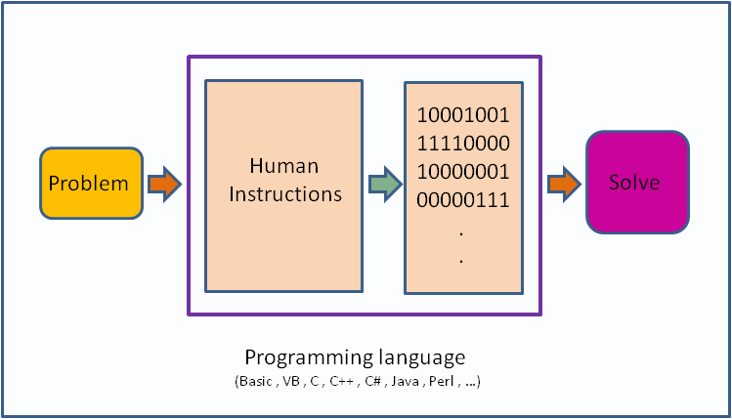

Slide 9
Its nearly impossible to write in Binary!

Slide 10
So we use programming language with Flowcharts & Algorithms for solving a Problem

Slide 11
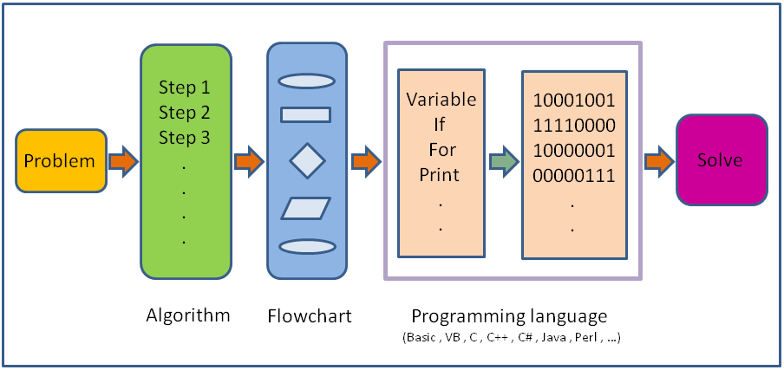

Slide 12
What is programming language?
A programming language is a set of rules that provides a way of telling a computer what operations to perform
It provides a linguistic framework for describing computations.
A programming language also has words, symbols and rules of grammar.
The grammatical rules are called syntax

Slide 13
High/Low Level Languages!
C++/ Java/ Python
Assembly language
Machine Code
ARM/MIPS/IBM
Notes:
In assembly language
add $r1, $r1, $r2
beq $r1, $r2, L1
j L1
li $t1, 5

Slide 14
How do we work with High Level?
Magic Box
sum = I + j;
Compiler
000000 00001 00010 00110 00000 100000
Linker
In High level
In Machine Code

Slide 15
Before we write a program for a solution we need an Algorithm.

Slide 16
So what is an algorithm?
An algorithm is a self-contained step by step set of operations to be performed in order to solve a problem.
Its an effective method that can be expressed within a finite amount of space and time and in well-defined formal language for solving a problem.
Another way to describe an algorithm is a sequence of unambiguous instructions.

Slide 17
Expressing Algorithms?
Algorithms can be expressed in many kind of notations, including natural languages, pseudocode, flowcharts, etc.
Natural Language expressions of algorithms tend to be verbose and ambiguous, and are rarely used for complex or technical algorithms.
Programming languages are primarily intended for expressing algorithms in a form that can be executed by a computer.

Slide 18
Two basic aspects of programming
Data
Instructions

Slide 19
To understand data we need to understand Variables!

Slide 20
What are Variables?
Variables in a computer program are analogous to Buckets or Envelopes where information can be maintained and referenced.
On the outside of the bucket is a name.
When referring to the bucket, we use the name of the bucket, not the data stored in the bucket.

Slide 21
Variable Actions!
Create one (with a nice name). A variable should be named to represent all possible values that it might contain. Some examples are: midterm_score, midterm_scores, data_points, course_name, etc.
Put some information into it (destroying whatever was there before). We "put" information into a variable using the assignment operator, e.g., midterm_score = 93;
Get a copy of the information out of it (leaving a copy inside). We "get" the information out by simply writing the name of the variable, the computer does the rest for us, e.g., average = (grade_1 + grade_2) / 2.

Slide 22
Now lets talk about Instructions!

Slide 23
What are instructions?
Its an order given to computer.
At lowest level each of these is a sequence of 0s and 1s.
In assembly language, each statement is one instruction but in high level each statement can be further broken into multiple steps.

Slide 24
Six basic computer instructions
Reading/Receiving some information
Outputting/Printing some information
Performing arithmetic operation
Assigning a value to a variable or memory location
Conditional Execution
Repeat a group of actions

Slide 25
Time for Flowcharts!

Slide 26
What is a flowchart?
Diagrammatic representation illustrating a solution to a given problem.
Allows you to break down any process into smaller steps and display them in a visually pleasing way
It shows steps as boxes of various kinds, and their order by connecting them with arrows.
It helps your audience to see the logical flow and relationship between steps.

Slide 27
Flowchart components
Start
Initializer / Terminator
Read N
Input / Output
Let Sum =0, I = 1
Process
Is I greater than N ?
Decision
Arrow
A
Connector

Slide 28
Lets look at few problems and their flowcharts!

Slide 29
Read Principal, Rate & Time and Print SI
Start
Read P, R, T
SI = (P*R*T)/100
Output SI
End

Slide 30
Find largest of three numbers
Start
Read A,B,C
Is A > B and
A > C
Yes
Print A
No
Is B > A and B > C
Yes
Print B
No
Print C
End

Slide 31
Read a & d, print 10 numbers of form a+d, a+2d, a+3d…
Start
Read a, d
Let I = 1
Is I <= 10
I = I + 1
Yes
Output term
No
End
term = a + I * d

Slide 32
Given N, print all numbers from 1 to N
Start
Read N
Let I = 1
Is I <= N ?
Add 1 to I
Yes
Output I
No
End

Slide 33
Time to try?
Read five numbers and print their average
Given N, find sum of even numbers from 1 to N
Given N, check if its prime or not

Slide 34
Check if a number is prime or not?
Start
Read N
I = 2
Is I < N ?
No
Print
“IS PRIME”
Add 1 to I
Yes
Is N divisible by I?
No
Yes
Print
“NOT PRIME”
End

Slide 35
Some more examples!

Slide 36
Find largest of N numbers
Start
Read N
Let I = 1, L = -1000000
Is I <= N ?
No
Output L
Add 1 to I
Yes
Read Num
End
Is Num > L ?
No
L = Num
Yes

Slide 37
Print the below pattern
*
**
***
****
*****
Start
I = I + 1
Read N
Print ‘\n’
Let I = 1
J = J + 1
Is I <= N ?
No
Print ‘*’
Yes
Yes
Is J <= I ?
Let J = 1
No
End

Slide 38
Time to try?
Given a list of N integers, find mean, maximum and minimum value. You would be given first N, and then N integers of the list.
Given a number check if it is a member of Fibonacci sequence or not
Read N, and print the following pattern
1
2 3
4 5 6
7 8 9 10
11 12 13 14 15

Slide 39
Pseudocode!

Slide 40
What is pseudocode?
A notation resembling a simplified programming language, used in program design
It allows designers or lead programmers to express the design in great detail and provides programmers a detailed template for the next step of writing code in a specific programming language

Slide 41
Notation for those basic six!
Reading/Receiving [ read N ]
Outputting/Printing [ print Sum, print “Coding Blocks”, print 1, print ‘\n’ ]
Assignment [Sum ← 5]
Arithmetic operators [ a+b, a * 5, sum + i ]
If Else [ if I < N then … else then … endif ]
While Loop [ while I < N do … endwhile ]

Slide 42
Lets convert some flowcharts into pseudocode!

Slide 43
Check if a number is prime or not?
Start
Read N
I = 2
Is I < N ?
No
Print
“IS PRIME”
Add 1 to I
Yes
Is N is divisible by I ?
No
Yes
Print
“NOT PRIME”
End

Slide 44
Pseudocode- Check if N is prime?
read N
I ← 2
While I < N do
if N is divisible by I then
print “NOT PRIME”
exit
endif
I ← I + 1
endwhile
print “IS PRIME”
exit

Slide 45
Find largest of N numbers
Start
Read N
Let I = 1, L = -1000000
Is I < N ?
No
Output L
Add 1 to I
Yes
Read Num
End
Is Num > L ?
No
L = Num
Yes

Slide 46
Pseudocode –Largest of N numbers
read N
I ← 1, L ← -100000
while I < N do
read num
if num > L then
L ← num
endif
I ← I + 1
endwhile
print L
exit

Slide 47
Lets try one more pattern!
1
123
12345
1234567
123456789
read N
i ← 1
while i <= N do
j ← 1
while j <= n-i do
print ‘ ‘
j ← j + 1
endwhile
j ← 1, value ← 1
while j <= 2*i - 1 do
print value
j ← j + 1
value ← value + 1
endwhile
print ‘\n’
i ← i + 1
endwhile
exit

Slide 48
Time to try?
Convert your flowcharts into pseudocode
Read N and print the below pattern
1
232
34543
4567654
567898765
Given a number N, find sum of its digits

Slide 49
Time for Brain Teasers!

Slide 50
BT - 1: Hour Glasses
You have two hourglasses: a 7 minute one and a 11 minute one. Using just two hourglass, accurately time 15 minutes.

Slide 51
BT – 2: Apples and Oranges
There are three closed and opaque cardboard boxes. One is labeled "APPLES", another is labeled "ORANGES", and the last is labeled "APPLES AND ORANGES". You know that the labels are currently misarranged, such that no box is correctly labeled. You would like to correctly rearrange these labels. To accomplish this, you may draw only one fruit from one of the boxes. Which box do you choose, and how do you then proceed to rearrange the labels?

Slide 52
BT – 3: Average Salary
Three coworkers would like to know their average salary. However, they are self-conscious and don't want to tell each other their own salaries, for fear of either being ridiculed or getting their houses robbed. How can they find their average salary, without disclosing their own salaries?

Slide 53
BT – 4: Criminal Cupbearers
An evil king has 1000 bottles of wine. A neighboring queen plots to kill the bad king, and sends a servant to poison the wine. The king's guards catch the servant after he has only poisoned one bottle. The guards don't know which bottle was poisoned, but they do know that the poison is so potent that even if it was diluted 1,000,000 times, it would still be fatal. Furthermore, the effects of the poison take one month to surface. The king decides he will get some of his prisoners in his vast dungeons to drink the wine. Rather than using 1000 prisoners each assigned to a particular bottle, this king knows that he needs to murder no more than 10 prisoners to figure out what bottle is poisoned, and will still be able to drink the rest of the wine in 5 weeks time. How does he pull this off?

Slide 54
What is next class about?

Slide 55
Programming Fundamentals - 1
Basic syntax of C++
Datatypes/Variables
Constants
If else
while

Slide 56
Thank You!
Prateek Narang

